Slide 1
Python for Data Analytics ByteSized Labs
November 10-12
Penn

Slide 2
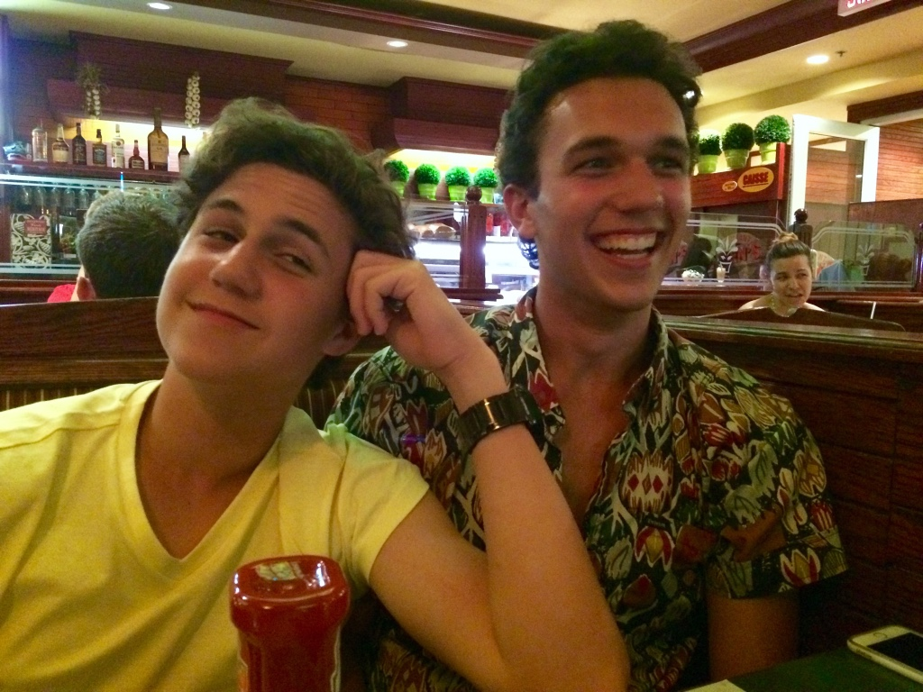
Your Instructors
Jesse Berliner-Sachs
Software Engineering at Hired Score Inc.
Head of Education @ ByteSized Labs

Slide 3
Why Learn Python?
Widely used in variety of industries and growing in popularity
Versatile, has a huge range of applications
Readable and easy to learn
Constantly improving and gaining new applications

Slide 4
Course Overview
9 Lessons + Set up
5 ”DIY’s” (5-10 minutes each)
On your own
4 Challenges (10-20 minutes each)
In pairs
The ByteSized Data-A-Thon (2.5 hours)
Groups of 3-4

Slide 5
Take-aways from the workshop
Confidence in your ability to write basic Python scripts
The ability to read and understand scripts written by others
Experience importing, analyzing, editing, and storing data
Experience conducting basic statistical operations on a real data set
The knowledge of how to expand on the skills you’ve learned and how to apply them to a broad range of purposes, fields, and industries

Slide 6
Course Schedule (tentative)
Friday
Lab: 3 - 6
Saturday
Lab: 10 – 1
Lunch: 1– 2
Lab: 2 – 4
Sunday
Lab: 10 – 1
Lunch: 1– 2
Data-A-Thon: 2 – 4:30
Project Presentations: 4:30 - 5

Slide 7
Course Companion Site
Found at learnpython.bytesizedlabs.com
Code Snippets
Every piece of code you see on screen can be found or downloaded from the website
Best if you follow along on the website while I’m describing on the board
DIYs
Challenges
Solutions
DON’T LOOK!!

Slide 8
How to succeed in this class
Pay attention
We move through a lot of material fast
Follow along with the code on your personal computer
Don’t copy and paste
Ask questions
Review briefly concepts after each day

Slide 9
Lesson 0: Setup
Topics: Shell commands, Python installation, “Hello world”

Slide 10
What is the Shell
Stop using the mouse and start using the keyboard!!
Shell is how we can interact with our computer
Mac:
⌘ [Space]
Type “Terminal”
Windows:
Open the Start Menu and type ”command”
Type “echo Hello World”

Slide 11
What are directories?
All files in your computer are organized into directories
“Directories” = Folders
The Shell lets you navigate through these directories
Directory commands:
“ls”
List everything in current folder
”cd”
Change directory
”cd ..” to change to parent directory
“cd ~” to change to root directory (mac only)

Slide 12
Shell Commands
“mkdir”
Make a new directory
“touch my_file.py”
Makes a new file in the current directory called my_file.py
“[tab]”
Auto complete
“[up/down arrow]”
Move through history of old commands

Slide 13
Make Your Workspace
“ls”
List everything in our home folder
”cd Desktop”
Change directory to Desktop
“mkdir bytesizedlabs”
Make a directory called bytesizedlabs on the desktop
“cd bytesizedlabs”
Change directory to workspace
“mkdir day1”
Make a directory called day1 in bytesizedlabs directory
“ls”
List to show that we made subdirectory

Slide 14
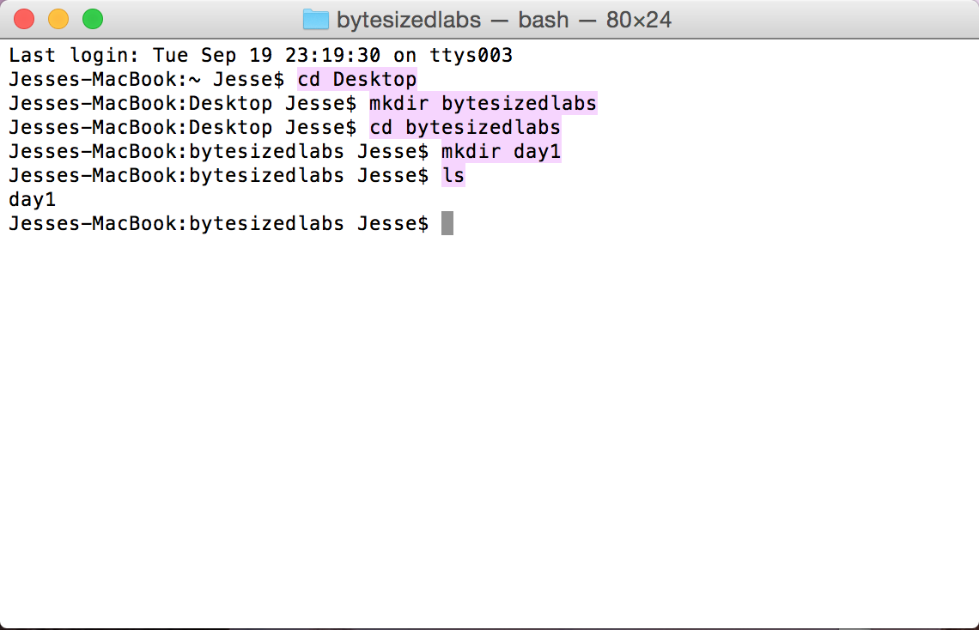
Make Your Workspace

Slide 15
The boring part
We’ve created files to download Python 3 and setup your shell for the workshop
Found on course website learnpython.bytesizedlabs.com under the setup tab
Download the setup file for your computer and put it in your bytesizedlabs directory

Slide 16
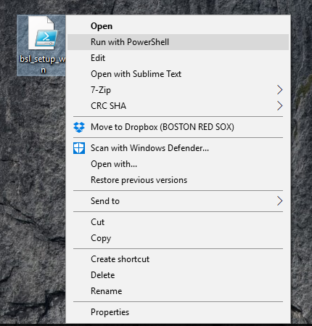
Setup - Windows
Right click on file
Choose “Run with PowerShell”

Slide 17
Setup - Mac
In Terminal, navigate to your bytesizedlabs folder
Type in Terminal:
“chmod +x bsl_setup_mac.sh”
“bash bsl_setup_mac.sh”

Slide 18
Sublime
The Shell is ugly
It’s ok for short commands but for our long programs we’re going to want something better
Sublime Text is a text editor that we have installed for you

Slide 19
What is Python?
Three more commands:
”python my_file.py”
Runs the file using python and prints the results to the shell
“python”
Opens python within the shell
Lets us run/test basic commands, math, imports, etc.
”subl my_file.py” (macs only)
Opens the file in Sublime for easy editing

Slide 20
Challenge 0: Hello World
Open Sublime and at the bottom right click “plain text” and change to python
In a new file type the following:
print(“Hello World !!!”)
Save file in Desktop/bytesizedlabs/day1 as hello_world.py
In the shell navigate to Desktop/bytesizedlabs/day1
Run command:
python hello_world.py

Slide 21
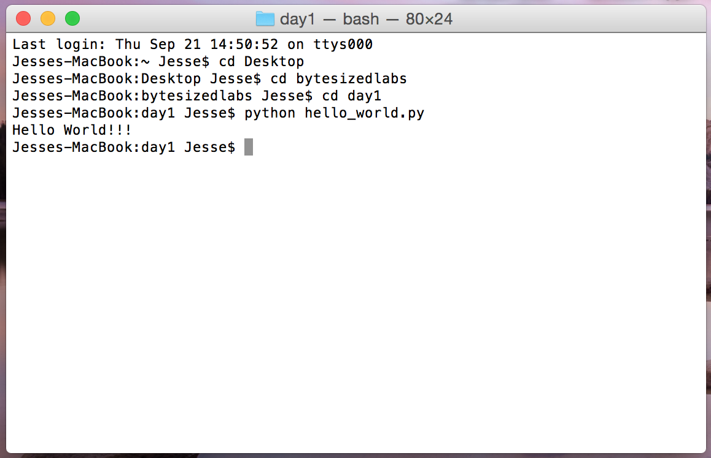
Challenge 0: Hello World
## 0 - Hello World
print("Hello World !!!")

Slide 22
You just wrote your first Python program!!!
Now that we’ve finished the boring stuff, let’s write some code

Slide 23
Lesson 1: Talk to me
Topics: Variables, User Input, Printing

Slide 24
Variables
A variable stores data (so we can use it again later)
We can define a variable like so:
These types of variables are known as strings. They represent a string of text
## 1 - Define Variables examples
byte_name = "Python for Data Analytics"
language = "Python"
location = "Philadelphia"

Slide 25
Variables
We can print variables like so:
## 2 - Print Variables
byte_name = "Python for Data Analytics"
language = "Python"
location = "Philadelphia"
print(byte_name) # "Python for Data Analytics"
print(language) # "Python"
print(location) # "Philadelphia"

Slide 26
Variables
We can combine strings like this
Look carefully at where the quotes are. Around the strings, not the variable names
Tip: Sublime uses colors to show what is a string and what is variable
## 3 - Combining Variables
language = "Python"
location = "Philadelphia"
sentence = "We are learning how to code " + language + ", in " + location
print(sentence) # "We are learning how to code Python, in Philadelphia"

Slide 27
Variables
A few things to remember when defining variables
Usually all lowercase letters with underscores “_”
Constants can be all uppercase
Always use descriptive names
BAD: variable1, my_variable, price
GOOD: car_price, profit_margin_as_percent, distance_left_to_travel
Variable name on the left, variable value on the right
Variable name without quotes

Slide 28
Comments
Computers read code but sometimes humans do too
Use # to mark line as a comment
We also use comments above all of our code snippets to number them for easy reference
## 4 - Comments
# This is a variable that stores the day of the week
day_of_week = "Friday"
# This is another variable that stores the time of day
time_of_day = "early afternoon"

Slide 29
User input
So far our programs just do actions but what if we want to interact with them?
We can get input from the shell like this:
## 5 - Input
name = input("What is your name? ")
quest = input("What is your quest? ")
favorite_color = input("What is your favorite color? ")
print("Hello " + name + ". I hear your quest is " + quest + ". Good luck!")

Slide 30
DIY: Let me tell you something…
Create a new file in day1 directory called “questions.py”
Write a program that asks the user for their name, age and why they want to learn python
Write a print statement combining those strings to make sentences describing the user using concatenation (“+”)

Slide 31
DIY Possible solution
## DIY_1 - Variables
name = input("What is your name? ")
age = input("What is your age? ")
why_python = input("Why do you want to learn Python? ")
print("Your name is " + name + ", You are " + age + " years old, "
+ "and you want to learn Python because" + why_python)

Slide 32
How we doing?
Too fast?
Too slow?
Too descriptive?
Not descriptive enough?
Thumbs up/down/sideways

Slide 33
Lesson 2: What’s your type?
Topics: Types, Ints, Floats, Bools

Slide 34
Types
So far we’ve seen one type of variable, strings
There are many more
We’re going to focus on 3 new types right now
ints
bools
floats

Slide 35
Types
Type | What data it holds | How to define | Examples
String | Any text | Use quotes “ or ‘ | “I’m going to make him an offer he can’t refuse”
Ints | Any integer value | Use numbers (no decimal) | 0, 4, -80, 65535
Bools | Either true or false | Use capital first letter | True, False
Floats | Any decimal value | Use numbers with decimal point | 4.6, 8.0, -1.1, 0.0, 3.14

Slide 36
Ints + Floats
We can do math!!
## 6 Math
cars_sold_per_day = 50
car_price = 3000
revenue_per_day = cars_sold_per_day * car_price
revenue_per_year = revenue_per_day * 365
car_production_cost = 1000
profit_per_car = car_price - car_production_cost
profit_margin = profit_per_car / car_price

Slide 37
More Math
## 7 More Math
nine = 3 ** 2
int_division = 5 // 2 # int_division == 2
float_division = 5.0 / 2.0 # float_division == 2.5
mod_1 = 10 % 3 # mod_1 == 1
mod_2 = 11 % 4 # mod_2 == 3
complicated_formula = 6 * (2.5 + 1) / (3 ** 2 % 4)
Parentheses work the same as you remember
PEMDAS

Slide 38
Bools
Bools can be manipulated with the three logical functions “and”, “or”, and “not”
## 8 - Bools
i_know_python = False
i_am_learning_python = True
i_am_working_hard = True
i_will_know_python = i_know_python or i_am_learning_python
i_will_know_python_soon = i_know_python or (i_will_know_python and i_am_working_hard)
im_not_learning_python = not i_am_learning_python

Slide 39
Bools
## 9 - More Bools
bool1 = True and False
bool2 = False or True
bool3 = True and not False
bool4 = (False or not True) and True
bool5 = (True and True and False) or not True

Slide 40
Changing between types
We can change a variable's type through casting
int(“6”) == 6
str(77) == “77”
float(4) == 4.0
Sometimes it’s useful to check a variable's type
type(4) == int
type(“I am a string”) == str
You will get errors if something goes wrong
int(“Hippo”)

Slide 41
Making Bools
Use ints to make bools
## 13 ints to bools
ticket_price = 15
ticket_price_is_high = ticket_price > 12
ticket_price_is_low = ticket_price <= 6
tickets_are_free = ticket_price == 0
tickets_are_not_free = ticket_price != 0

Slide 42
Common Type Mistakes
”4” is a string not an int
“True” is a string not a bool
true (lower case) is not a bool
2 is an int
2.0 is a float
= assigns a value to a variable
== checks for equality

Slide 43
DIY: Types
Create a new file in day1 directory called “types.py”
Have the program ask the user for the price of something
Convert this string to an int
Add a 20% tax to the price
Convert the price with tax back to a string
Print out the response in a full statement

Slide 44
DIY Possible solution
## DIY_2 - Types
price_as_str = input("What is the price? ")
price_as_int = int(price_as_str)
price_with_tax = price_as_int + (price_as_int * 0.2)
print("The price with tax is " + str(price_with_tax))

Slide 45
Lesson 3: If you don’t mind
Topics: If-statements, None type

Slide 46
If-Statements
Sometimes we only want to execute code if something is True
## 10 - If statement
tickets_to_buy = 3
ticket_price_is_low = True
if ticket_price_is_low:
tickets_to_buy = tickets_to_buy + 3
print("Buy " + str(tickets_to_buy) + " tickets")

Slide 47
If-else-Statements
We can add an optional else statement
## 11 if-else statement
tickets_to_buy = 3
if ticket_price_is_low:
tickets_to_buy = tickets_to_buy + 1
print("Buy " + str(tickets_to_buy) + " tickets")
else:
tickets_to_buy = tickets_to_buy - 1
print("Buy " + str(tickets_to_buy) + " tickets")

Slide 48
If-elif-else-Statements
We can even add other elif’s
Will go through the clauses until one is true. If none are true will execute the else
## 12 if-elif-else statement
tickets_to_buy = 3
if ticket_price_is_low:
tickets_to_buy = tickets_to_buy + 3
elif ticket_price_is_high:
tickets_to_buy = tickets_to_buy - 3
else:
tickets_to_buy = tickets_to_buy - 1
print("Buy " + str(tickets_to_buy) + " tickets")
Notes:
Note that print statement is outside of if block so always executed## 12 if-elif-else statement
tickets_to_buy = 3
if ticket_price_is_low:
tickets_to_buy = tickets_to_buy + 3
elif ticket_price_is_high:
tickets_to_buy = tickets_to_buy - 3
else:
tickets_to_buy = tickets_to_buy - 1
print("Buy " + str(tickets_to_buy) + " tickets")

Slide 49
If-Statements
What you need
A Boolean condition (bool)
A colon
Some indented code
[optional] 1 or more elif statements
[optional] 1 else statement

Slide 50
DIY: If statements
Create a new file if_statments.py
Define a float variable “portfolio_returns” that is between 0 and 1
Create an if-elif-else statement that prints:
“My portfolio has very high returns” if the return percent is greater than 12%
“My portfolio has high returns” if the return percent is greater than 12% but less than 8%
“My portfolio has bad returns” otherwise

Slide 51
DIY Possible solution
## DIY_3 - If Statements
portfolio_return = 0.15
if portfolio_return > 12.0 / 100:
print("My portfolio has very high returns")
elif portfolio_return > 8.0 / 100:
print("My portfolio has high returns")
else:
print("My portfolio has bad returns")

Slide 52
None type
None represents the lack of data
Every type we’ve learned can also be None (not “none”)
## 15 None
bad_kanye_albums = None

Slide 53
Other types in if statements
One last weird but useful thing about if statements
All expressions can be converted to Bool for if statements
Ints and Floats
0 or 0.0 becomes False, everything else becomes True
Strings
Empty string “” becomes False everything else becomes True
None is always false

Slide 54
Other types in if statements
## 16 other types in if
number_of_problems = 99
if number_of_problems:
print("I have " + str(number_of_problems) + " problems.")
else:
print("Lucky you. Problem free")

Slide 55
Challenge 1: Hospital Efficiency

Slide 56
Challenge 1
You are the operations manager for a major hospital. You’re looking to make your nurses more effective by removing the repetitive tasks they have to do. One such task is calculating how much pain medication to administer a patient. The amount of medication a patient should receive is one tablet for every 50 pounds the patient weighs but never more than 3 tablets.
Write a program that asks the patient their weight and returns the number of tablets they should take?
(In a real world situation you’d have a “smart” IOT device to get patient weight, not just ask them)

Slide 57
How to approach this Assignment
Break into parts to solve individually
Questions to ask yourself
How will you get the patients weight?
How will you make sure their weight is the right type
How will you calculate how many tablets they should take?
What will you do if their weight says they should take more than 3 tablets
Bonus:
What if the patients can only take an integer number of tablets (i.e. not 1.75)
Hint: you can round a number with “round(7.8) == 8”

Slide 58
Example Solution
## Challenge 1 Solution - Hospital Optimization
weight_as_str = input("What is your weight? ")
weight_as_int = int(weight_as_str)
number_of_tablets = weight_as_int / 50
if number_of_tablets > 3:
number_of_tablets = 3
number_of_tablets = number_of_tablets - (number_of_tablets % 1)
print("You should take " + str(number_of_tablets) + " tablets")

Slide 59
Tomorrow
We start in the same room at 10am
We’ll finish around 4pm
There will be breaks and we’re providing lunch
Topics: Lists, Tuples, Dictionaries, Loops, Functions, Reading and Writing Files
Brief HW: Read over the code_snippets.py file on the website. Make sure you understand every line and what it’s doing (the ones we covered). Take note of what’s confusing and we’ll review tomorrow

Slide 60
Python for Data Analytics ByteSized Labs
November 10-12
Penn

